Slide 1
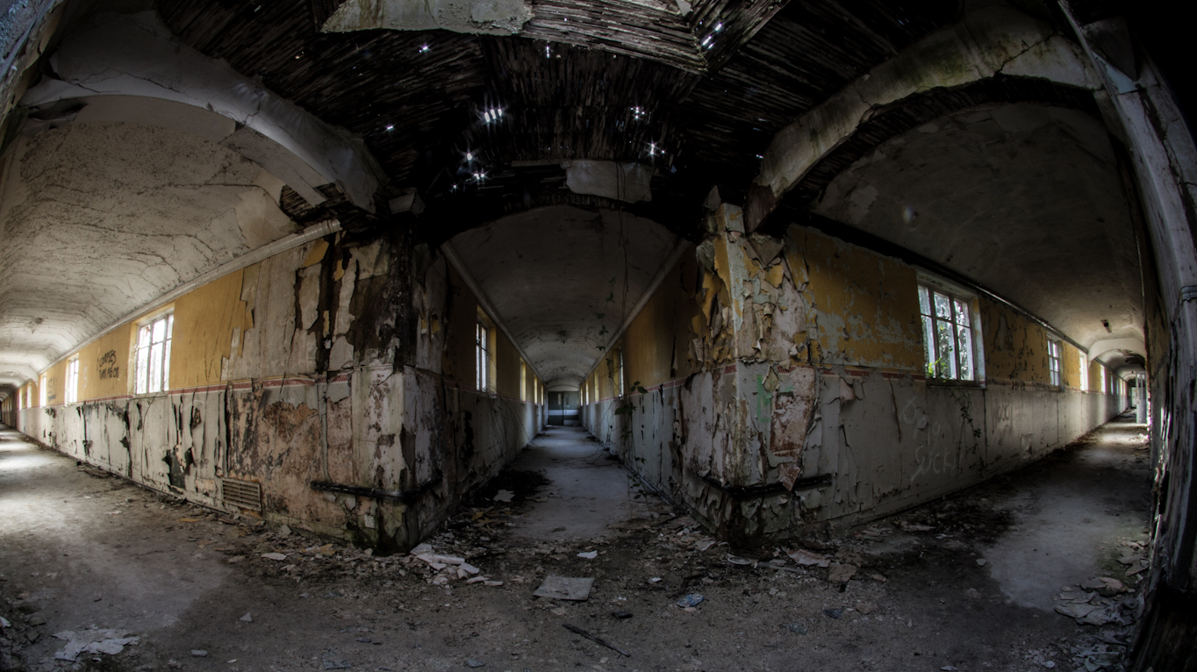
THE WARD
Developed by Team 12

Slide 2
Game Overview
# TEXT HERE

Slide 3
Features
ASCII
# TEXT HERE
Audio
# TEXT HERE

Slide 4
Third Party Libraries
Pillow
# TEXT HERE
Simple Audio
# TEXT HERE

Slide 5
Demonstration
# TEXT HERE

Slide 6
Questions?
# TEXT HERE

